Slide 1


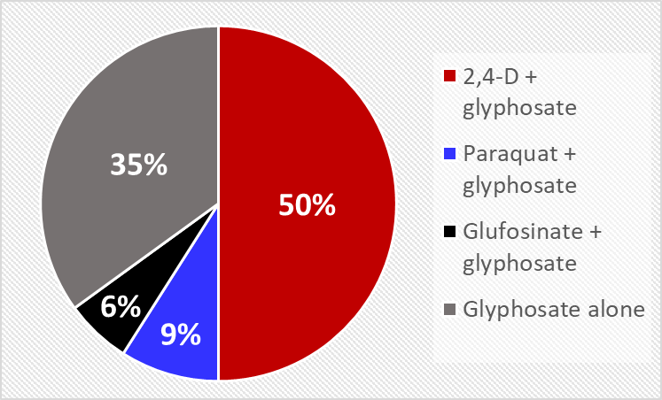
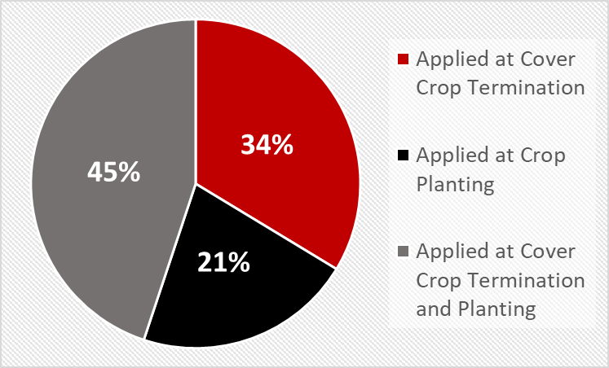
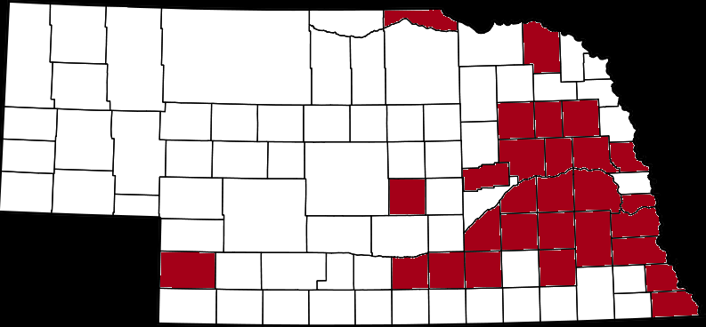
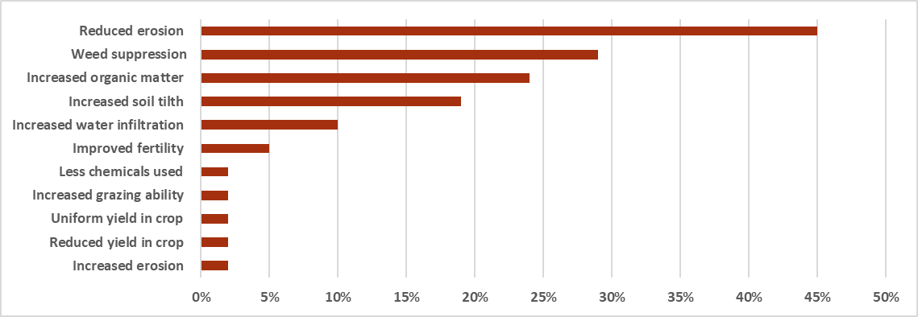
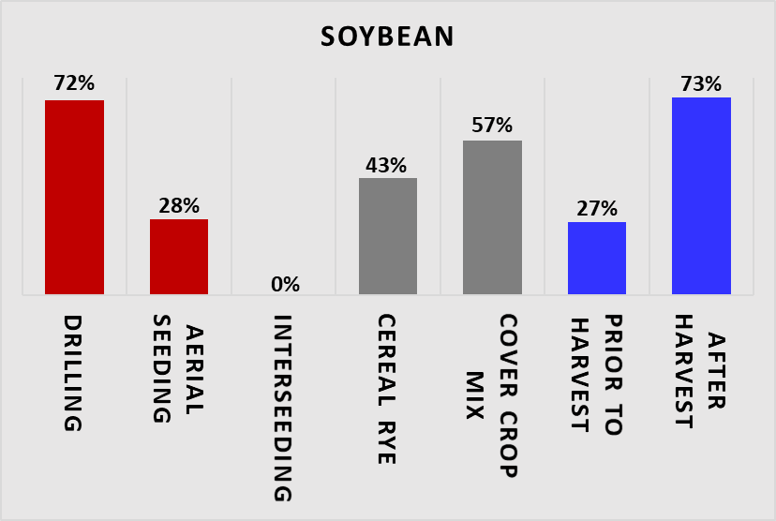
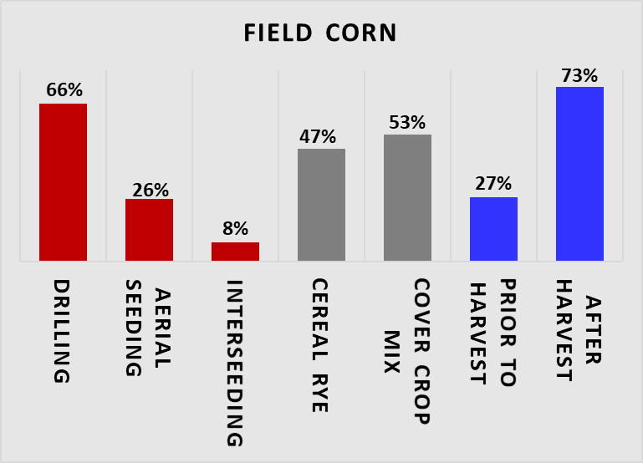
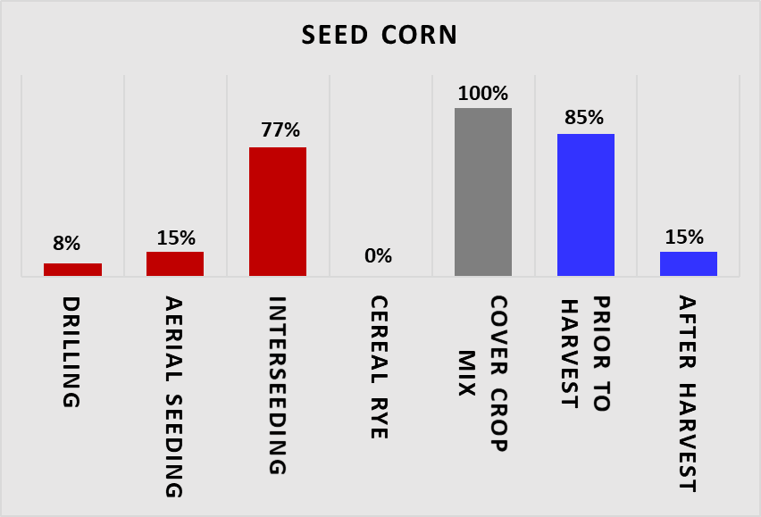
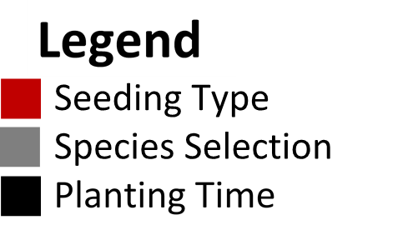
Survey of Cover Crop Management In Nebraska
Liberty Butts, Cropping Systems Research Technologist
Rodrigo Werle, Nebraska Extension Cropping Systems Specialist
Introduction
Cover crop (CC) use is becoming increasingly popular across Nebraska and the Midwest.
Potential benefits of CC include reduced erosion, increased soil organic matter and water holding capacity, and weed suppression.
Potential challenges associated with CC include proper and timely establishment and termination, labor and cost, and decreased water availability to subsequent crop.
Objective
Evaluate cover crop management strategies adopted by Nebraska soybean, field corn, and seed corn producers and agronomists.
Materials and Methods
A paper survey was conducted during the 2017 Cover Crop Conference, held on February 14 2017 at the Eastern Nebraska Research and Extension Center, near Ithaca, NE.
Results were compiled into an Excel spreadsheet.
A total of 82 growers and agronomists, representing 28 counties (mainly from eastern Nebraska), completed the survey (Figure 1).
Results presented herein are expressed as percentage of total responses from those who incorporate CC in their cropping systems.
Figure 1. Nebraska counties represented by survey respondents.
Participant Demographics
Of the 82 individuals that participated, 66 identified themselves as growers and 7 as agronomists/consultants.
Eighty-seven percent of survey respondents adopt CC as part of their cropping systems.
The total hectares farmed/managed by respondents was 149,331, with a total of 24,237 hectares planted with CC.
Results (cont.)
Cover Crop Termination and Herbicide Program
More than 95% of respondents use herbicides for cover crop termination in the spring.
Where herbicides are used; 100% of respondents use glyphosate.
As part of the tank-mix with glyphosate for CC termination, 50%, 9% and 6% of respondents include 2,4-D, paraquat, and glufosinate, respectively (Figure 5).
In the spring, when adopted, PRE-emergent herbicides are applied at cover crop termination (33%), crop planting (21%), and at both termination and crop planting (44%; Figure 6).
Figure 5. Herbicides used for CC termination. Figure 6. Application time of PRE herbicides.
Impact of Cover Crop Adoption in Production Systems
Reduced soil erosion was the main benefit reported by respondents (45%), followed by weed suppression (29%) and increased soil organic matter (24%) (Figure 7).
Of those reporting increased weed suppression, 79%, 26%, and 55% reported suppression of winter annual weeds, early season summer annual weeds, and late season summer annual weeds, respectively.
Figure 7. Production factors influenced by the incorporation of CC according to survey respondents.
Challenges with Cover Crops Incorporation
The biggest challenge reported was planting and establishing a stand before winter due to the lack of growing season left, time and/or equipment (56%).
Termination of cover crops in the spring was ranked as the second biggest challenge (37%).
Herbicide carryover impeding cover crop establishment in the fall (7%), cost (5%), and crop yield reduction (2%) were the remaining challenges reported by the respondents.
Results
Cover Crop Seeding Strategy, Species Selection, and Planting Time
Seeding strategy, species selection, and planting time adopted by survey respondents are crop dependent (Figures 2, 3, and 4):
Conclusions
The adoption of CC is increasing across Nebraska and beyond. There are many ways CC can be incorporated in cropping systems and the results of this survey highlight the main strategies, benefits, and challenges experienced by CC adopters.
When deciding how best to use CC, it is im­portant to consider the ultimate goal such as
increase soil organic matter, increase nutrient availability to subsequent crops, reduce soil
compaction, and/or suppress weeds.
These survey results will assist guiding CC management recommendations, research, and extension efforts in Nebraska.
Acknowledgements
Thank you to the growers and consultants for participating in the survey, UNL Extension Educator Keith Glewen for allowing us to conduct this survey, and WCREC Office Associate Jacqueline Herrick for compiling the survey results.
The full report with the survey results can be viewed at:
http://cropwatch.unl.edu/author/liberty-butts-cropping-systems-research-technologist
Figure 2. Seeding strategy, species selection, and planting time for CC following soybean.
Figure 3. Seeding strategy, species selection and planting time for CC following field corn.
Seeding Strategy
Figure 4. Seeding strategy, species selection, and planting time for CC following seed corn.

